Slide 1
Diffraction

Slide 2
Goals
To see how a sharp edge or an aperture affect light
To analyze single-slit diffraction and calculate the intensity of the light
To investigate the effect on light of many closely spaced slits

Slide 3
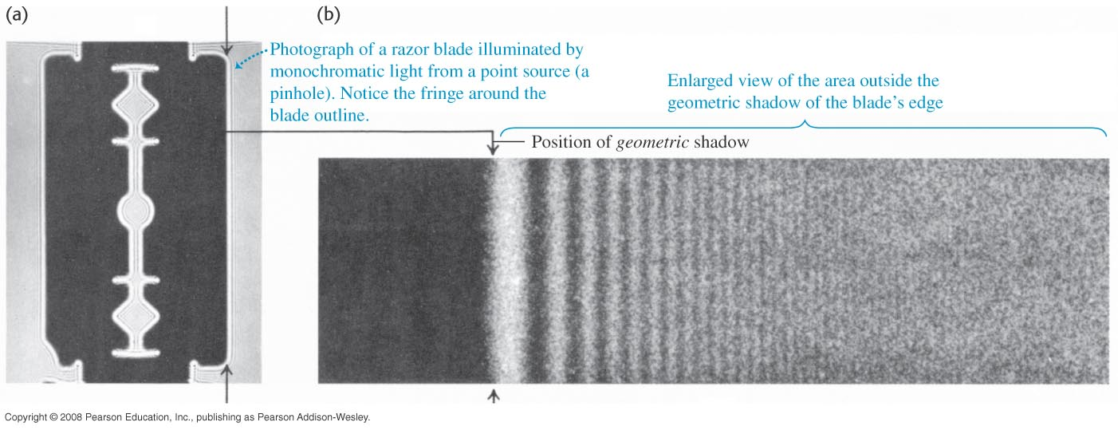
Diffraction and Huygen’s Principle
Huygens’s principle can be used to analyze diffraction.
Fresnel diffraction: Source, screen, and obstacle are close together.
Fraunhofer diffraction: Source, screen, and obstacle are far apart.
Figure below shows the diffraction pattern of a razor blade.

Slide 4
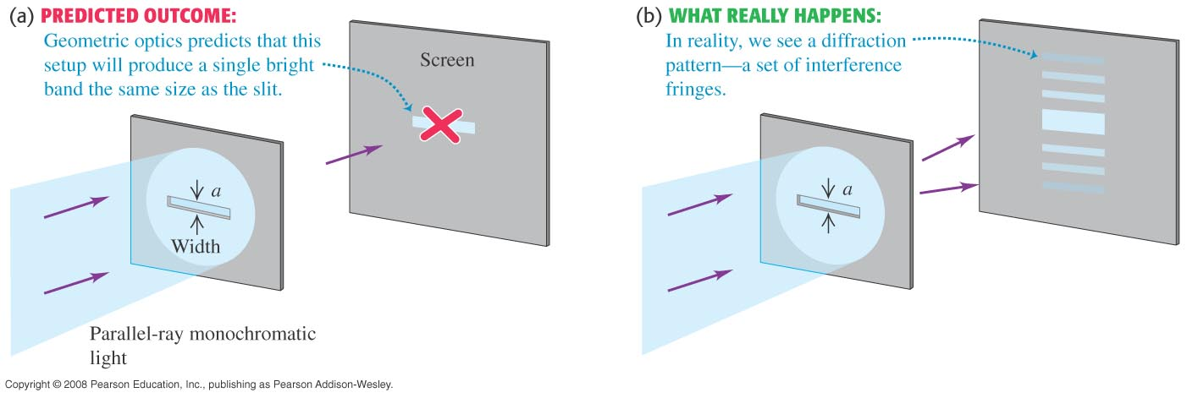
Diffraction from a single slit
In Figure 36.3 below, the prediction of geometric optics in (a) does not occur. Instead, a diffraction pattern is produced, as in (b).
The narrower the slit, the broader the diffraction pattern.

Slide 5
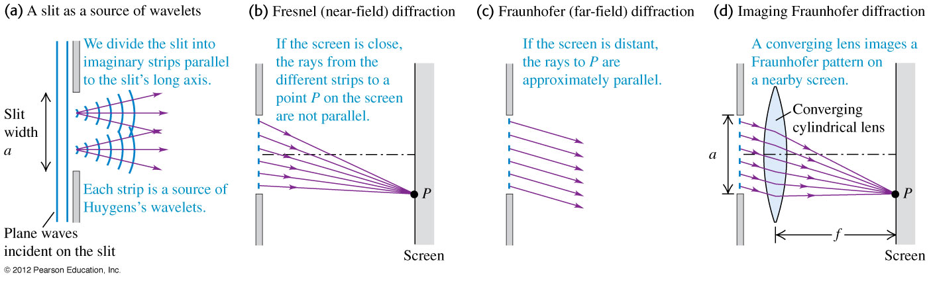
Fresnel and Fraunhofer diffraction by a single slit
Figure 36.4 below shows Fresnel (near-field) and Frauenhofer (far-field) diffraction for a single slit.

Slide 6
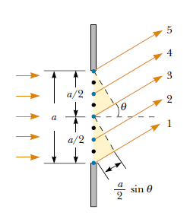




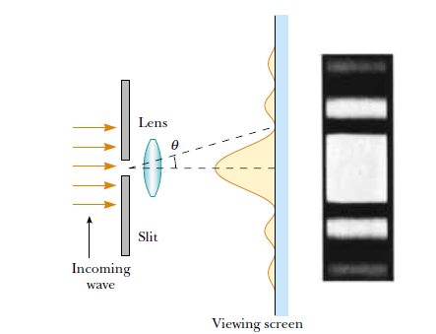





Diffraction by a single slit
To analyze the diffraction pattern , divide the slit into two half as shown in Figure . Path different between ray 1 and 3 or 2 and 4 or 3 and 5 are same. If path difference accommodates half wavelength ,then the observed pattern would be dark
If we divide in to 4 equal half
D
If we divide in to 6 equal half
In genera, condition for destructive interference becomes
y_{m = m}^{th} _{dark ring}

Slide 7
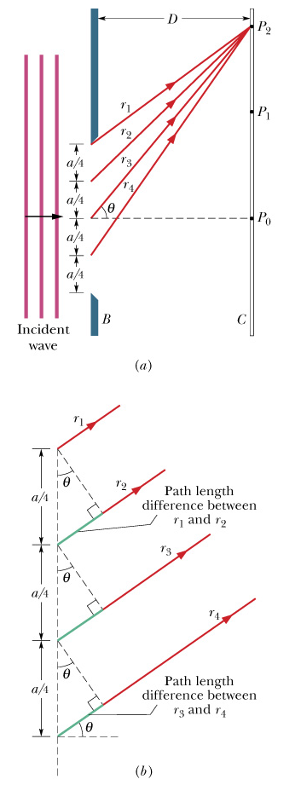

Diffraction by a Single Slit - Subsequent Minima
Repeat the process for paired rays (4) from corresponding points from each of the zones
Rays are in phase at the slit but must be out of phase by by λ/2 at screen
second minimum
Dark fringes - minima

Slide 8
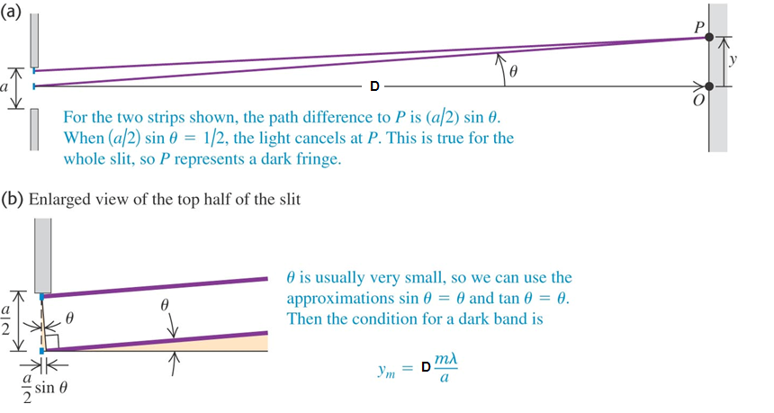
Locating the dark fringes
Follow the single-slit diffraction discussion in the text.
Figure 36.5 below shows the geometry for Fraunhofer diffraction.

Slide 9

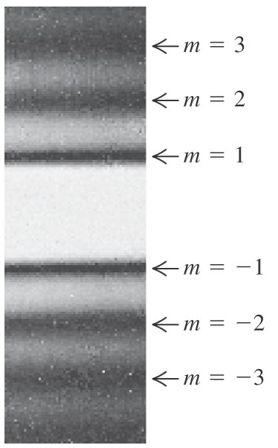
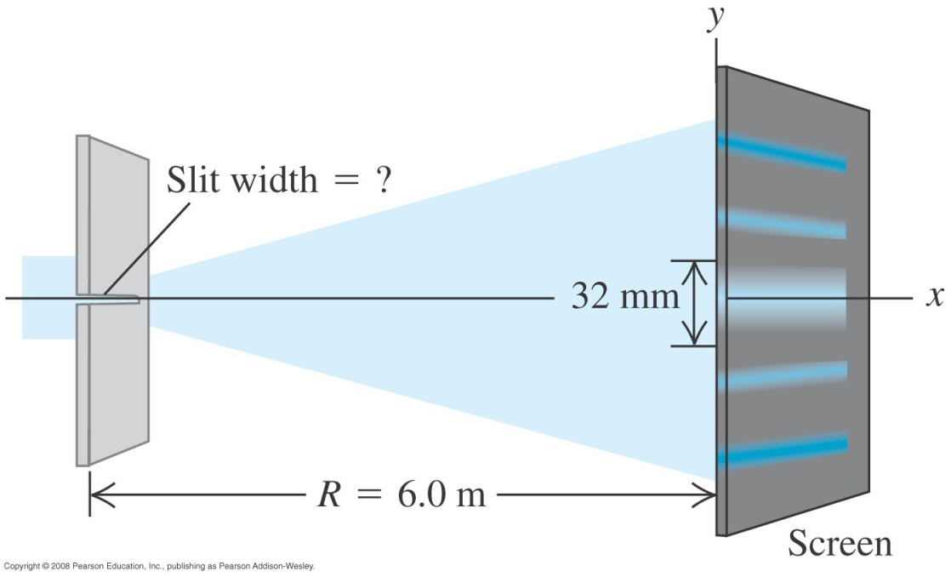
An example of single-slit diffraction
Figure 36.6 (bottom left) is a photograph of a Fraunhofer pattern of a single horizontal slit.
Example 36.1: You pass 633-nm light through a narrow slit and observe the diffraction pattern on a screen 6.0 m away. The distance at the screen between the center and the first minima on either side is 32 mm long. How wide is the slit?

Slide 10
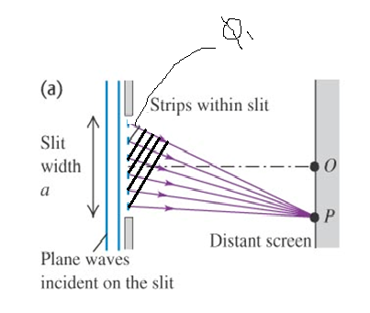
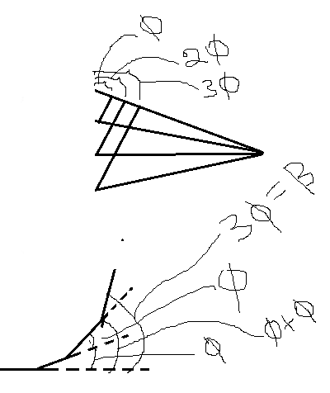
Intensity in the single-slit pattern

Slide 11
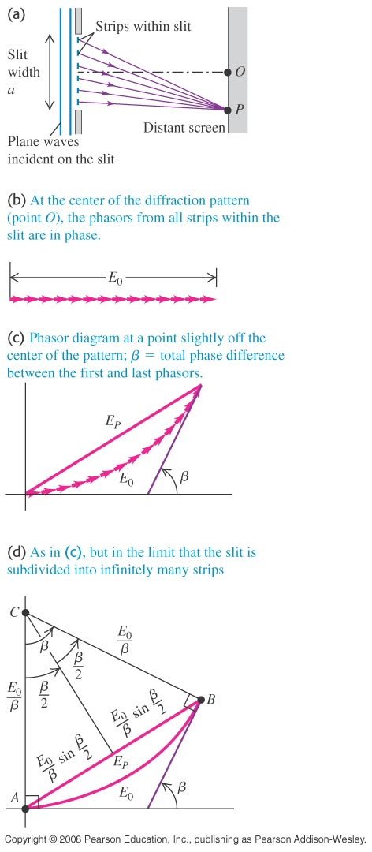
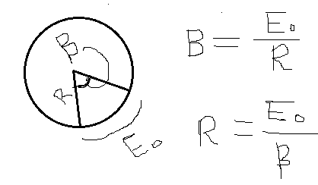
Intensity in the single-slit pattern
Follow the text discussion of the intensity in the single-slit pattern using the phasor diagrams in Figure 36.8 below.

Slide 12
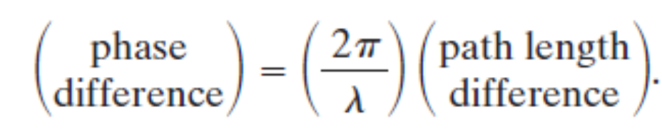
Intensity in the single-slit pattern
The intensity of the light at P is then proportional to the square of that amplitude.
To find E, we need the phase relationships among the arriving wavelets. The point here is that in general they have different phases because they travel different distances to reach P.
The phase difference between wavelets from adjacent zones
is given by

Slide 13
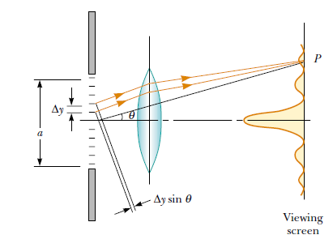



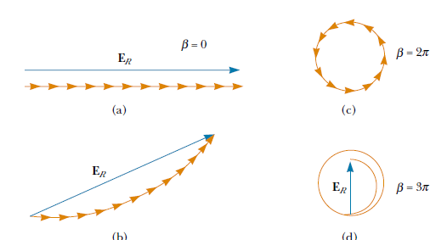

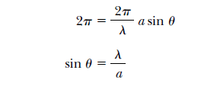
Intensity in the single-slit pattern

Slide 14
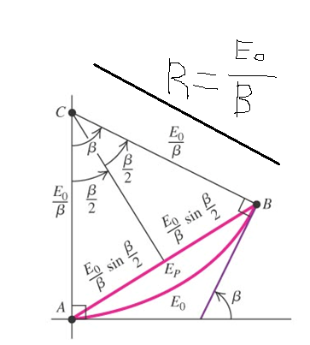




Quantitative Intensity in the single-slit pattern
Follow the text discussion of the intensity in the single-slit pattern using the phasor diagrams in Figure 36.8 below.
The angle β is the phase angle of the ray from the top of the slit, while the phase angle from the bottom of the slit is 0. The vectors lie along a circle whose center is at C, so E_{p} is a chord of the circle. The arc length E₀ is subtended by this same angle β, so the radius of the circle is E₀/β.
From the diagram,
(sinc function)

Slide 15
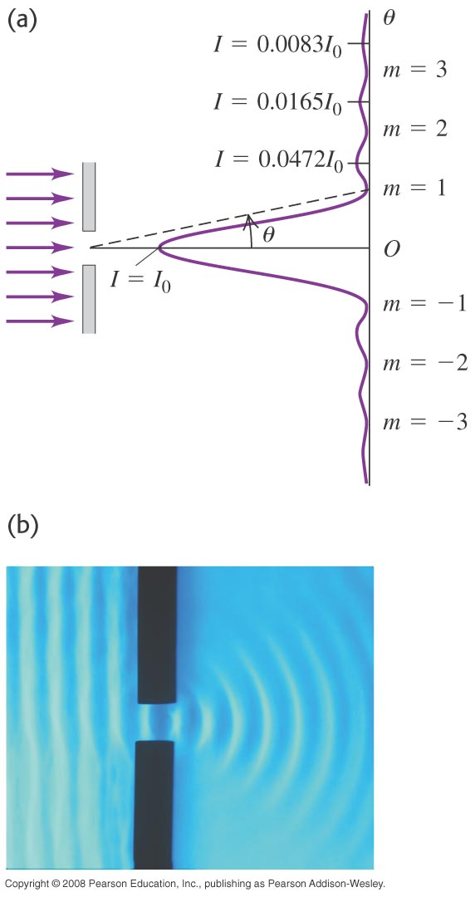
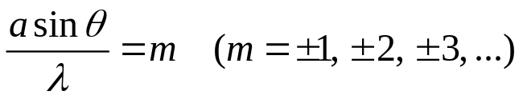
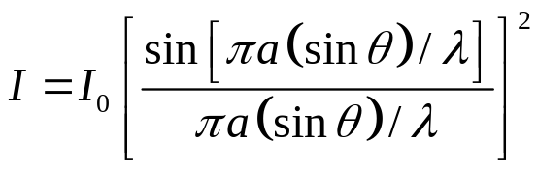

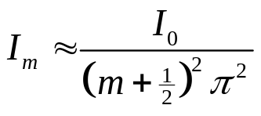
Intensity maxima in a single-slit pattern
Figure 36.9 at the right shows the intensity versus angle in a single-slit diffraction pattern.
The minima occur when β is a multiple of 2π, i.e. at
The location of the maxima are found by taking the derivative of
and setting it to zero. Surprisingly, these are not precisely where
In fact, there are no maximum for m = 0 in this expression. The central maximum is wider than the others, and occurs at θ = 0.
Using these approximate values of β in the intensity, we find

Slide 16
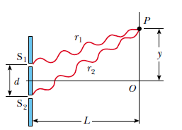








Two slits of finite width- Recap……

Slide 17
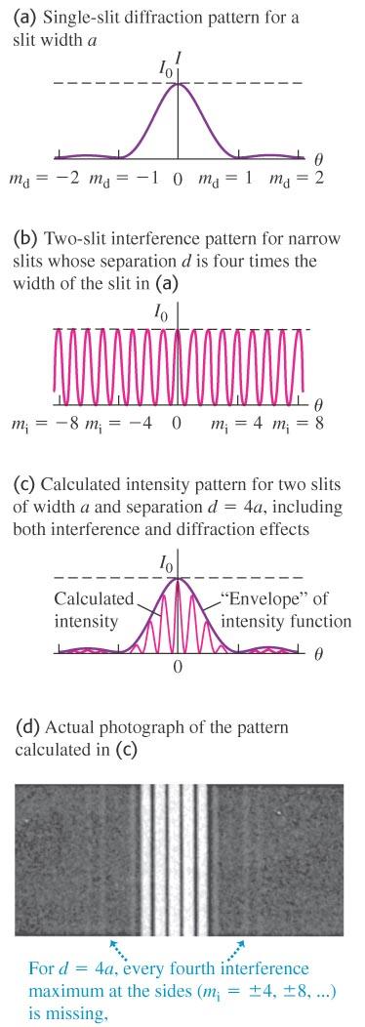
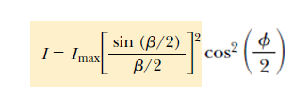
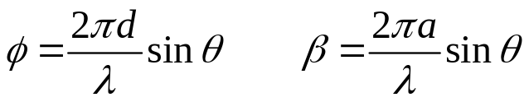
Two slits of finite width
When we discussed two-slit interference, we ignored the width of each slit. When we demonstrated it, however, we saw clearly the effect of the slit widths.
The overall pattern of two finite-width slits is the product of the two patterns, i.e.
d- Distance of separation of two slits
a- width of each slit

Slide 18


Two-Slit Diffraction Patterns, Maxima and Minima
To find which interference maximum coincides with the first diffraction minimum.
  The conditions for the first interference maximum
    d sin θ = m λ
  The conditions for the first diffraction minimum
    a sin θ = λ

Slide 19
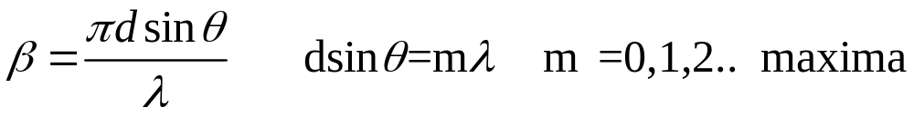
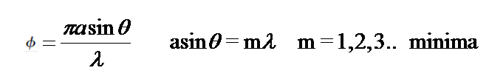
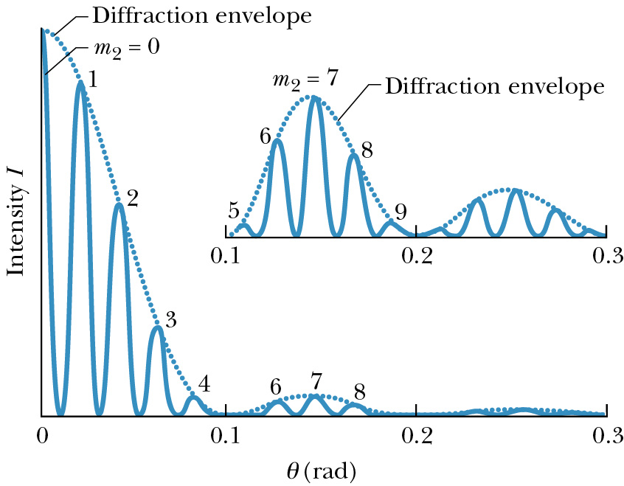

Diffraction and Interference by a double slit
I = I (double slit interference) x I(diffraction)

Slide 20
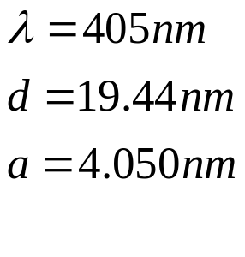
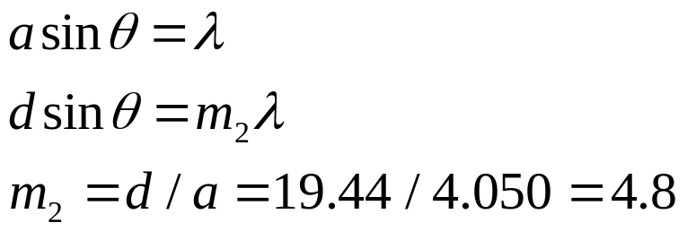
How many bright interference fringes fall within the central
peak of the diffraction envelope?
The idea here is to find
the angle where the first
minimum occurs of the diffraction
envelope.
Given
2 refers to double
slit interference
We have m=0 and
m=1,2,3 and 4 on both
sides of central peak.
Answer is 9

